Slide 1
Diverging exchange force and form of the
exact density matrix functional
Notes:
1

Slide 2
Outline
(I) Introduction into RDMFT
(II) Geometric picture underlying RDMFT
Translationally-invariant systems
(solid state physics, ultracold fermionic atoms)

Slide 3
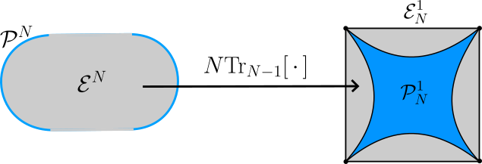
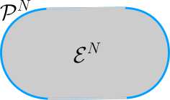
(I) Introduction into RDMFT

Slide 4
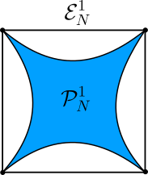

Slide 8
(II) Geometric picture underlying RDMFT

Slide 11
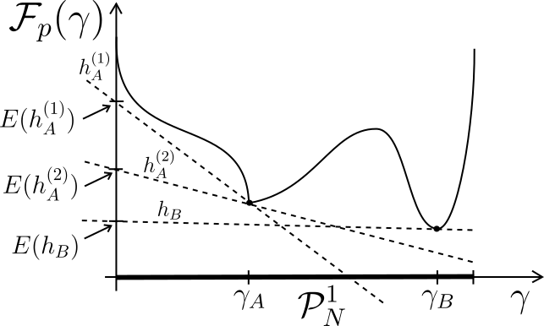

Slide 12
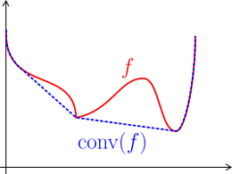

Slide 13
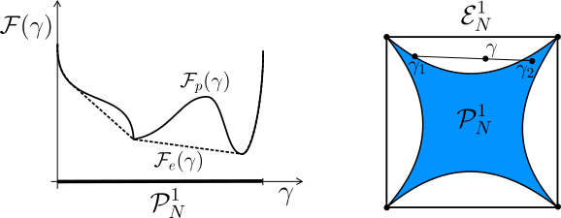

Slide 14
Translationally-invariant systems

Slide 15
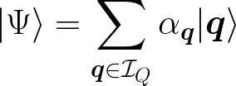

Slide 19
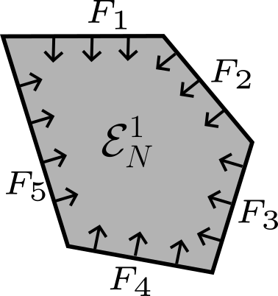

Slide 21
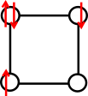
Application/Illustration: Hubbard square

Slide 22
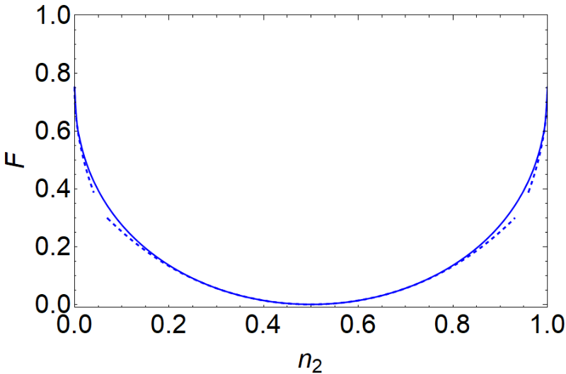
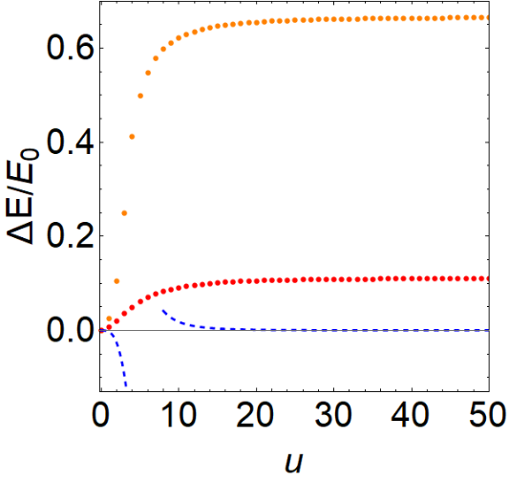

Slide 23
Summary and Conclusion

Slide 24
Outlook and open Problems

Slide 25
Thank you!

Slide 29
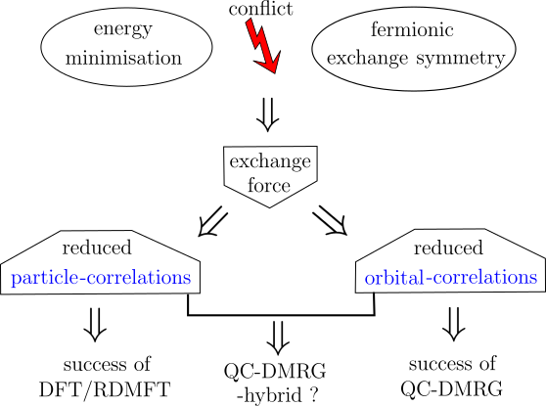

Slide 30
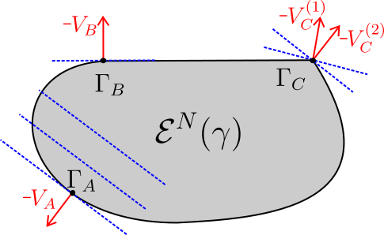

Slide 31
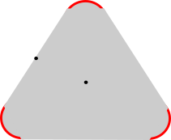

Slide 33
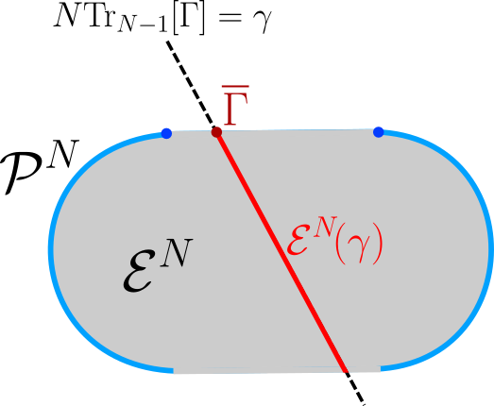

Slide 34
